Slide 1
LEGACY OF THE 20th CENTURY
In the 20th Century as never before mans greed for ever increasing profits, his ever increasing intolerance of his fellow man and the other creatures which inhabit the Earth we live in, is bringing about destruction of our environment at an ever increasing rate.
These actions are summarised below
Pollution & Destruction of the Countryside
Destruction of Forestation
A Threat to Wildlife
Pollution of both Rivers & the Sea
Pollution of the Air
Pollution of the Food Chain
Inability or unwillingness of Government to STOP the process

Slide 2
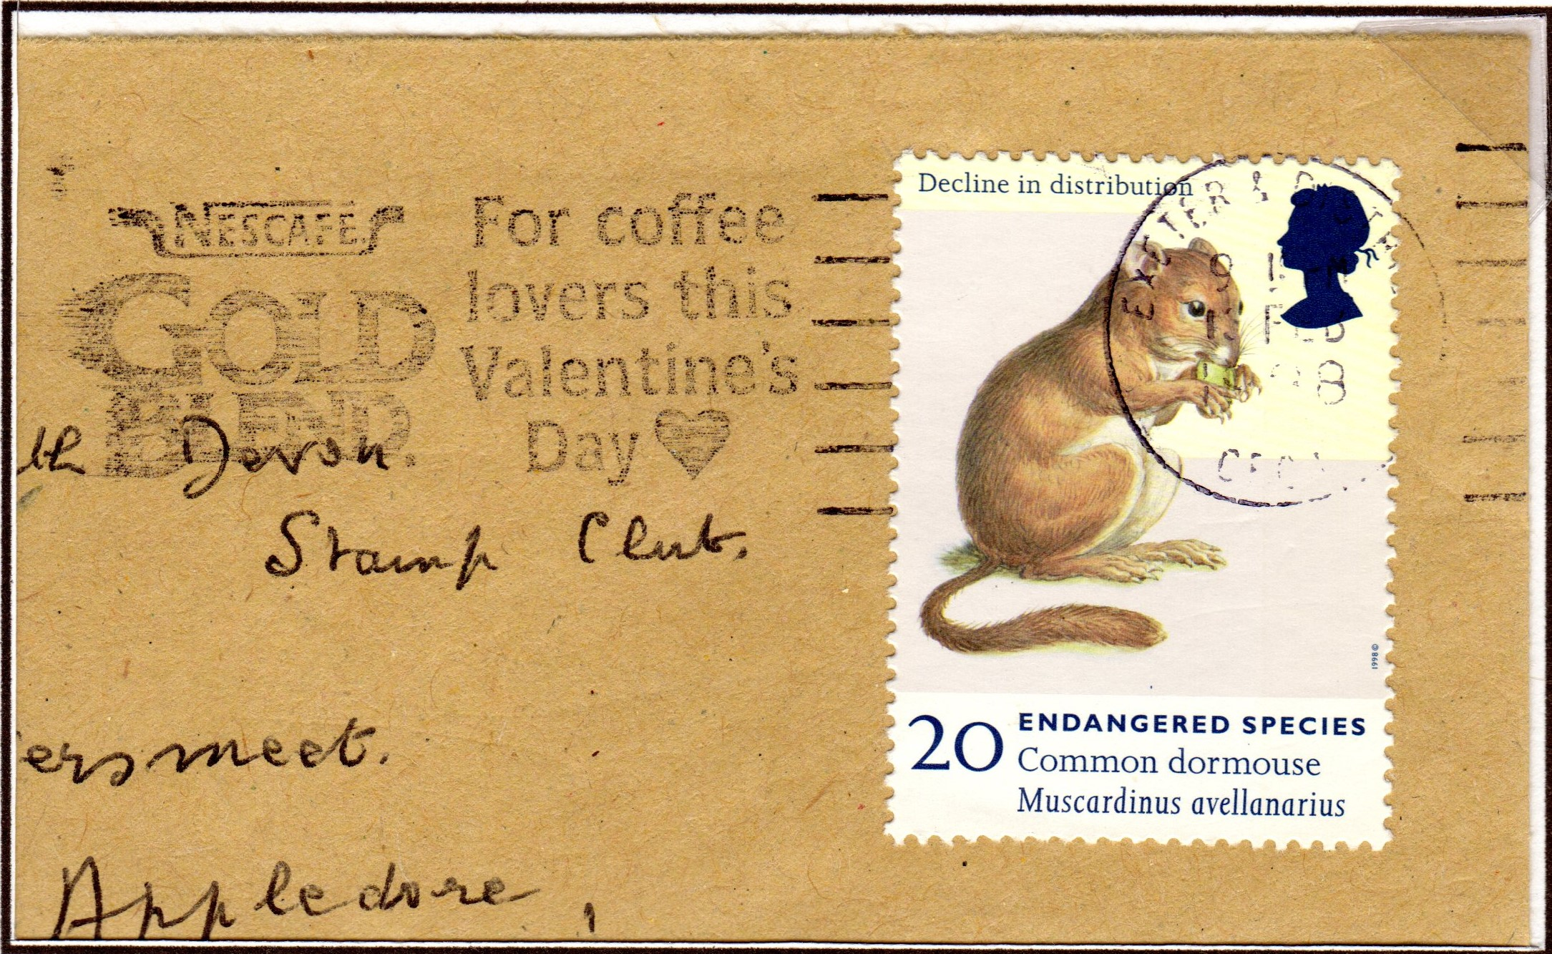
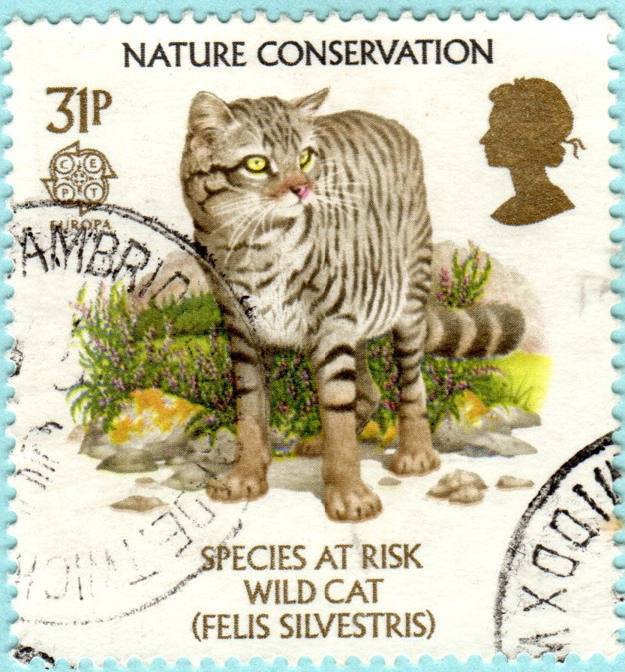
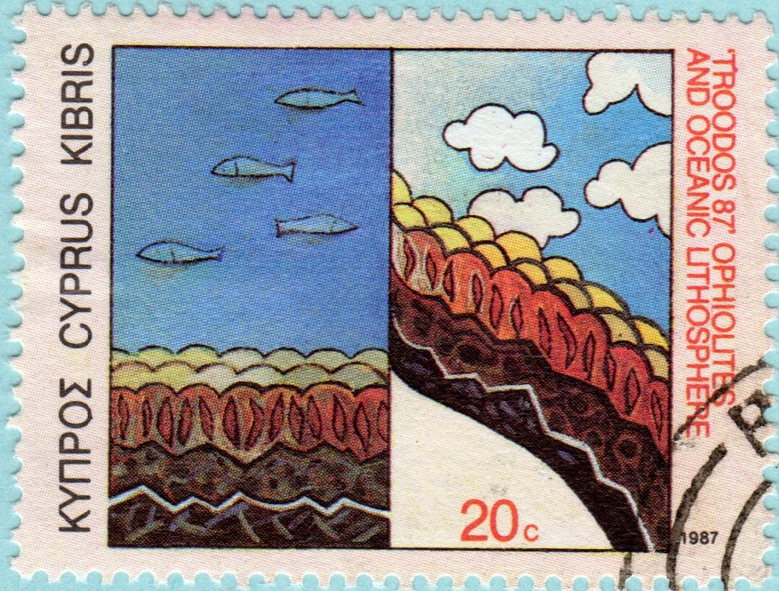
DOES ANYBODY CARE
We may be Coffee lovers but do we care enough to do something about the endangered species
We are constantly bombarded with the message of conserving nature and planting for the future. Do we actually care enough to actually do something about it?
Will there be a Partridge in a Pear Tree?
And more importantly WILL ANYBODY CARE

Slide 3
POLLUTION & DESTUCTION OF THE COUNTRYSIDE
Wild places are under threat from the ever increasing use of the Countryside for Building and the trampling underfoot by those who insist on the right to roam.
When was the last time you saw some of these?

Slide 4
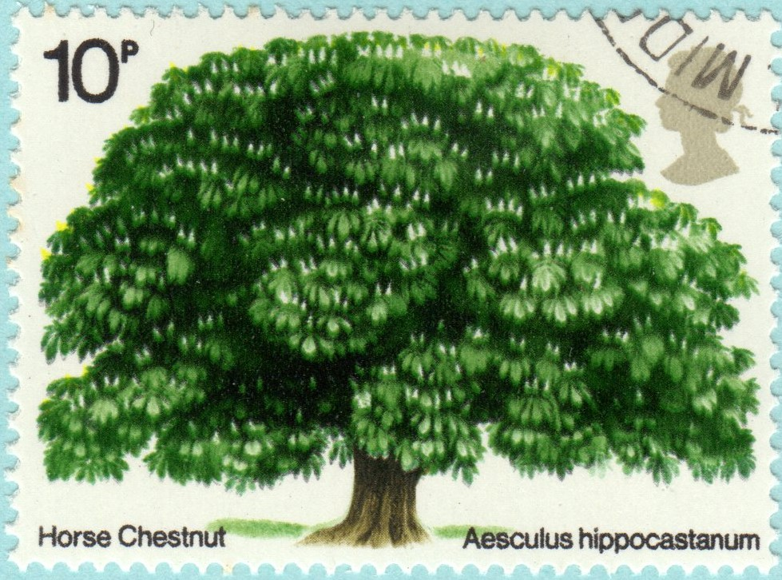
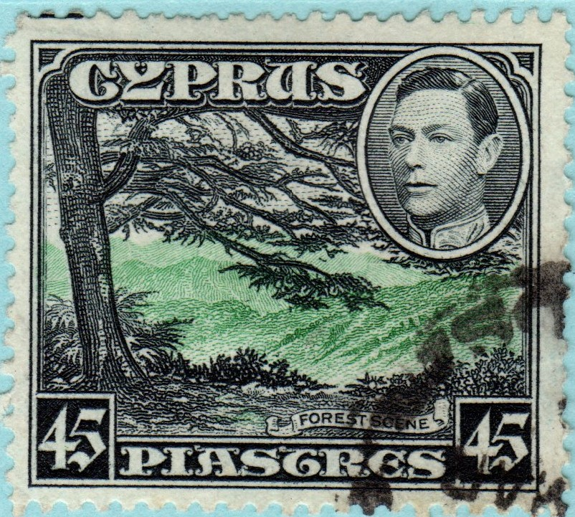
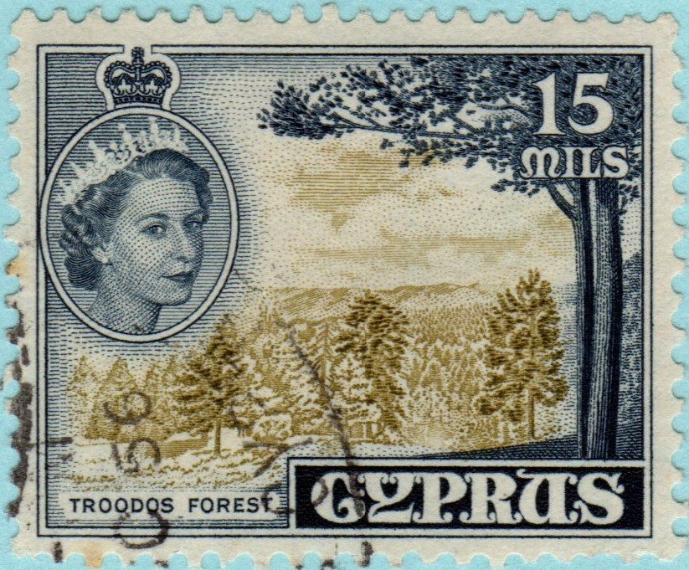
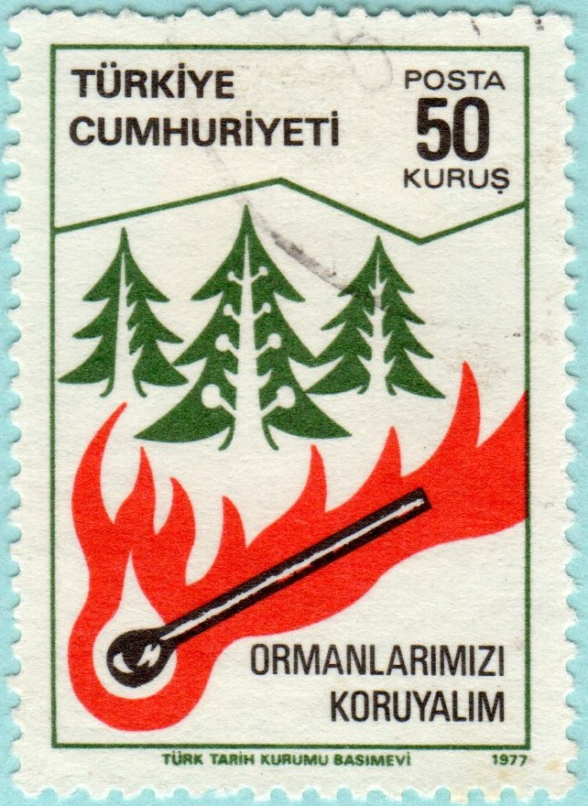
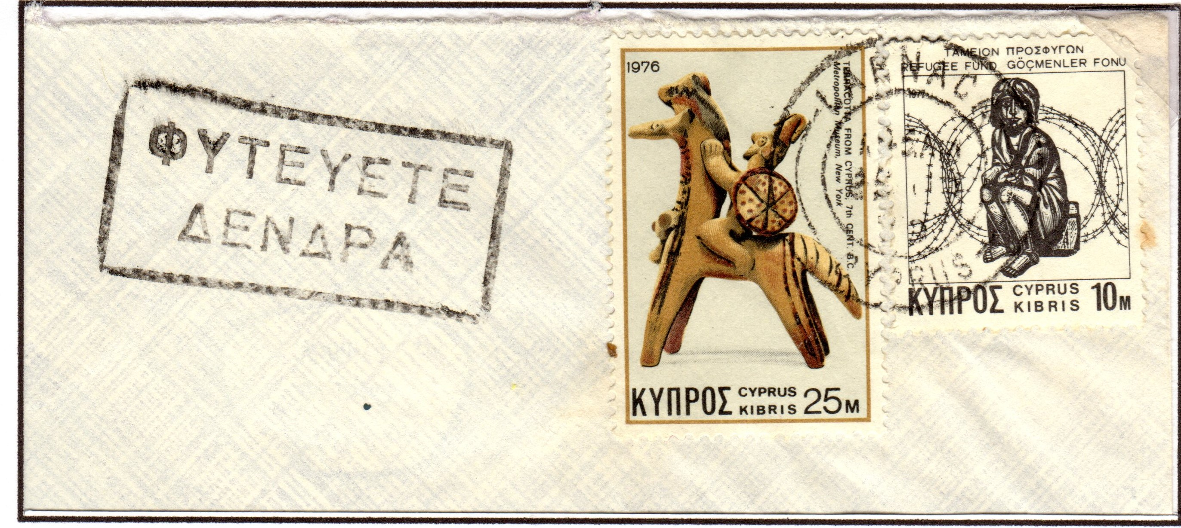
DESTRUCTION OF FORESTATION
Broad leafed trees similar to that shown here are now very scarce mostly replaced by Pine Trees that grow faster but do not help the environment
Much of the worlds forest is being deliberately set alight to create farmland that soon turns into Dessert
WHAT IS BEING DONE TO STOP THIS PRACTISE – VERY LITTLE
The slogan shown left implores us to “SAVE TREES”

Slide 5
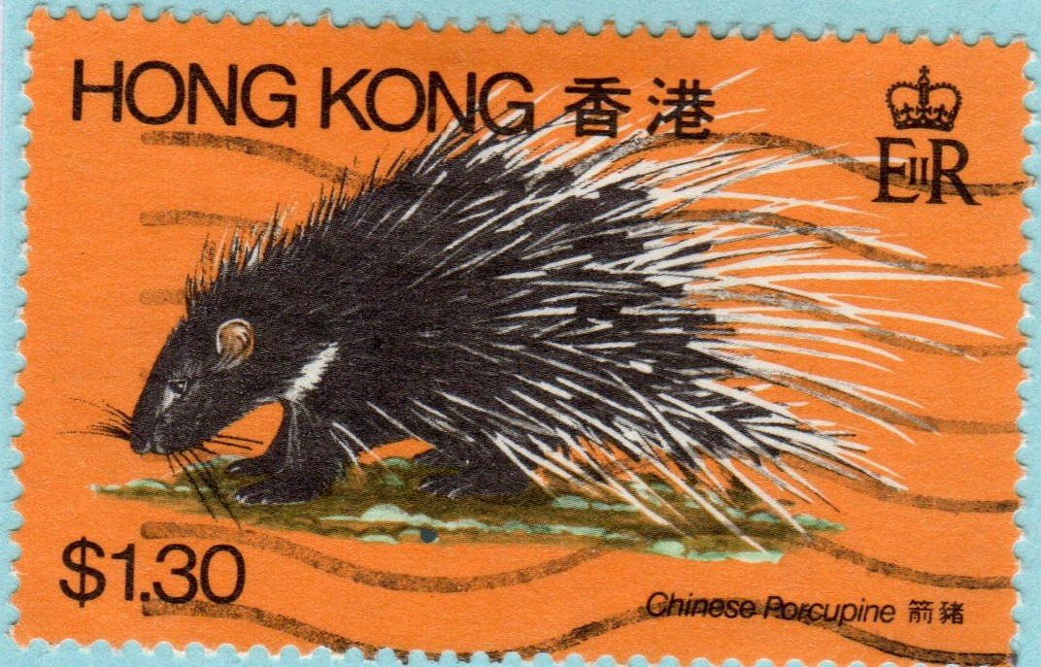
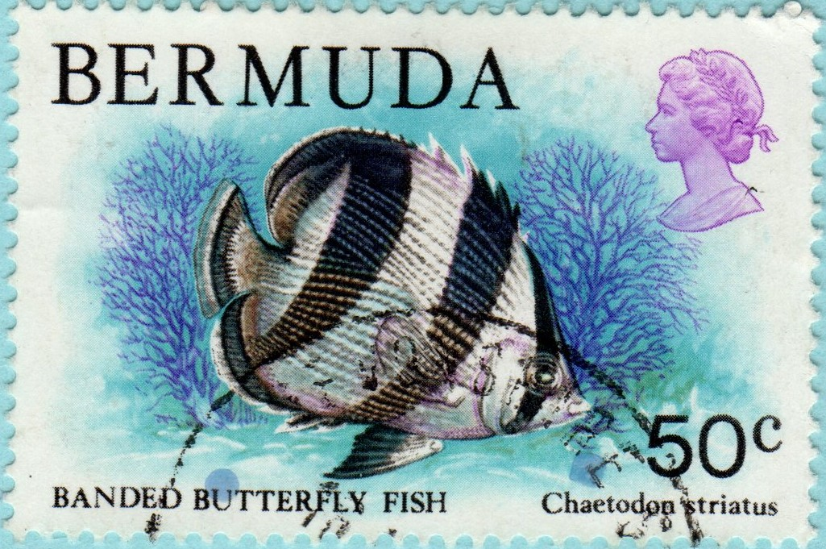
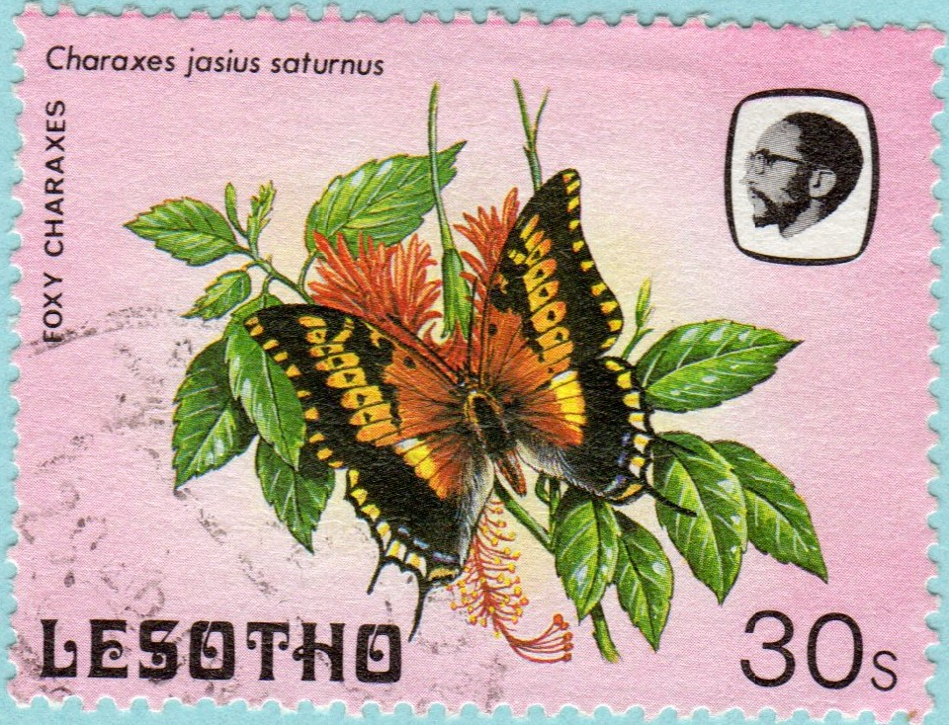
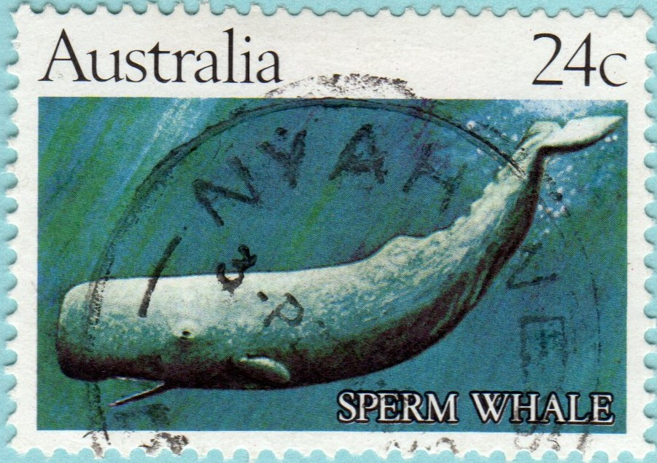
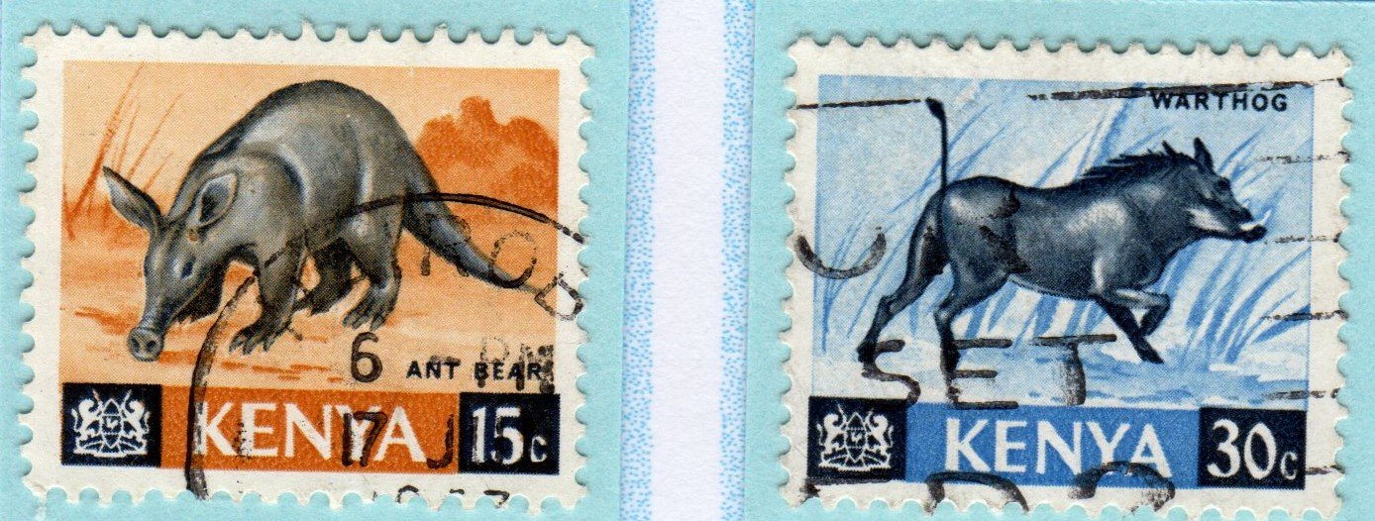
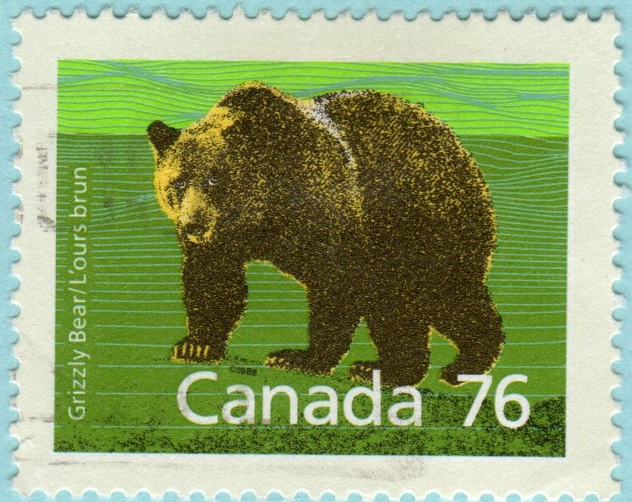
A THREAT TO WILDLIFE
Mans polluting and exploitation of our Planet is putting pressure on the Wildlife population and bringing about the total extinction of many species

Slide 6
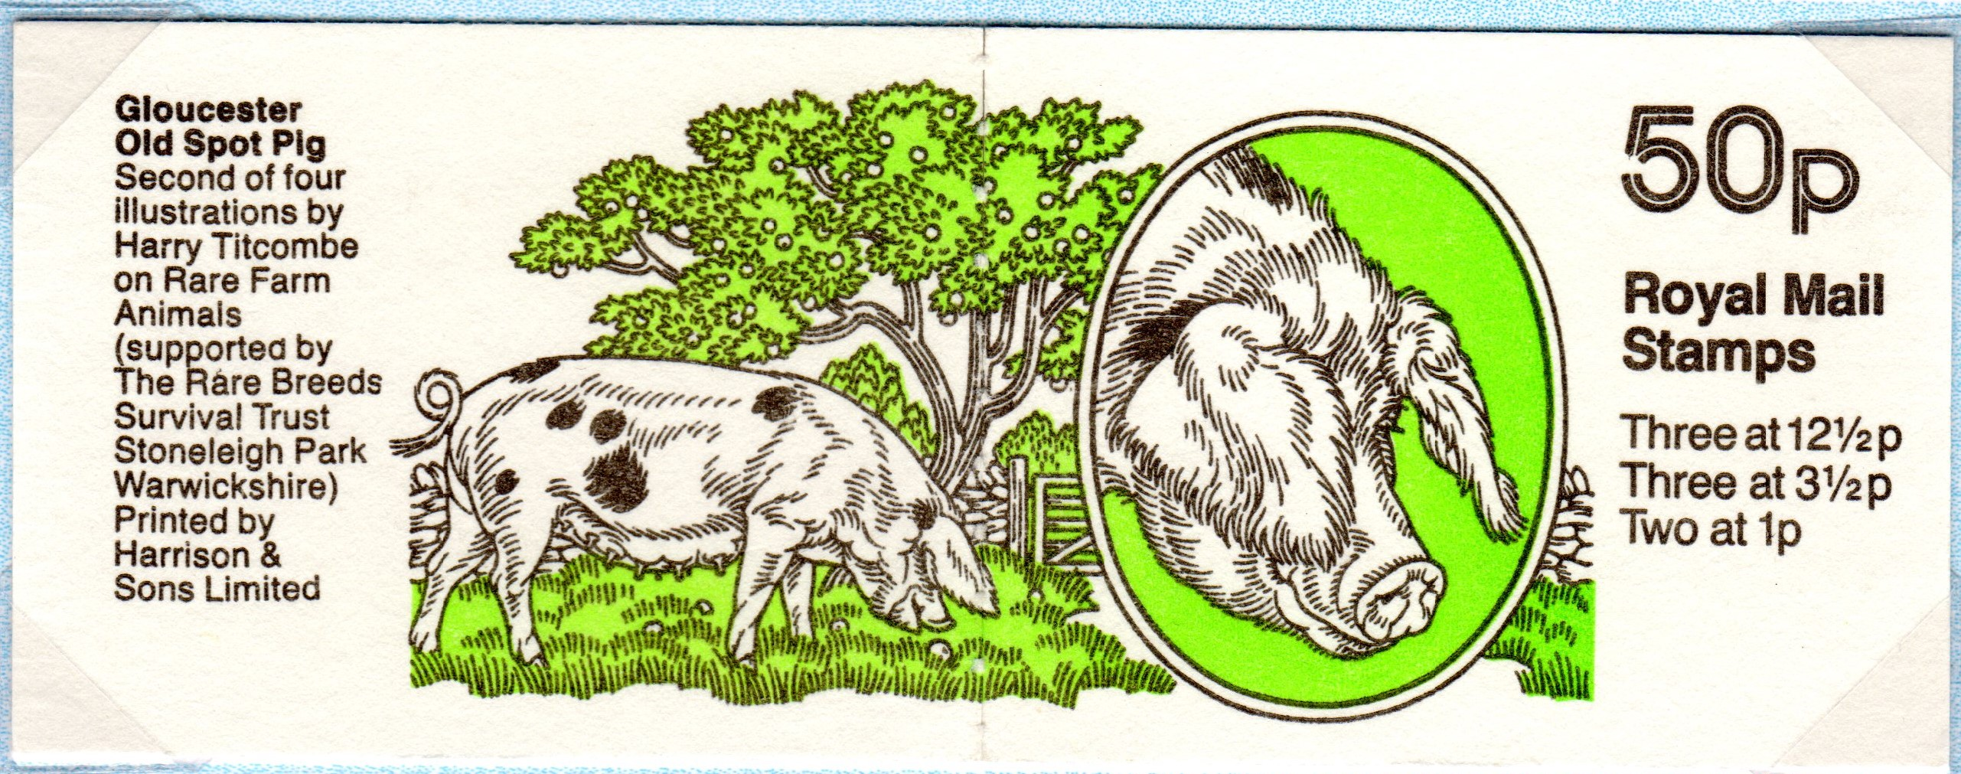
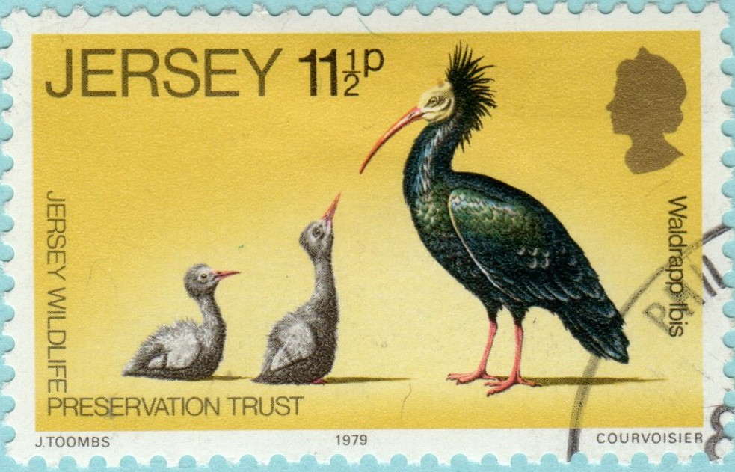
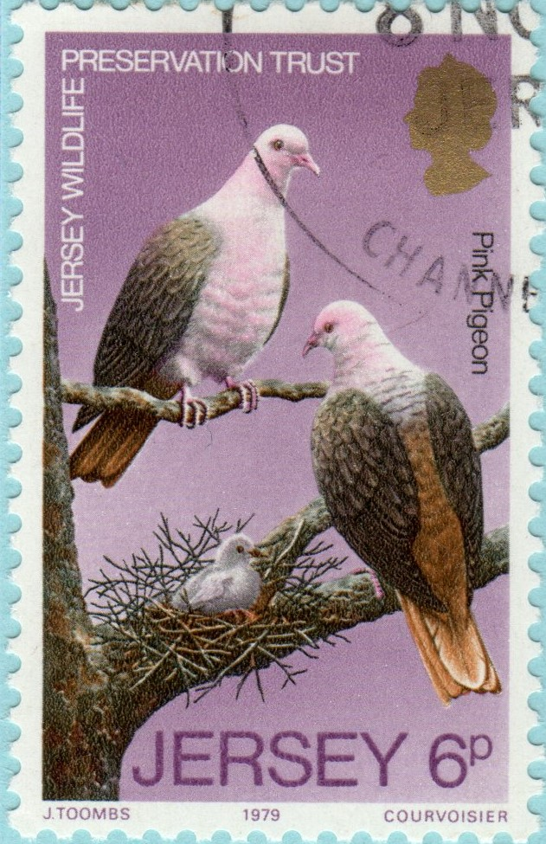
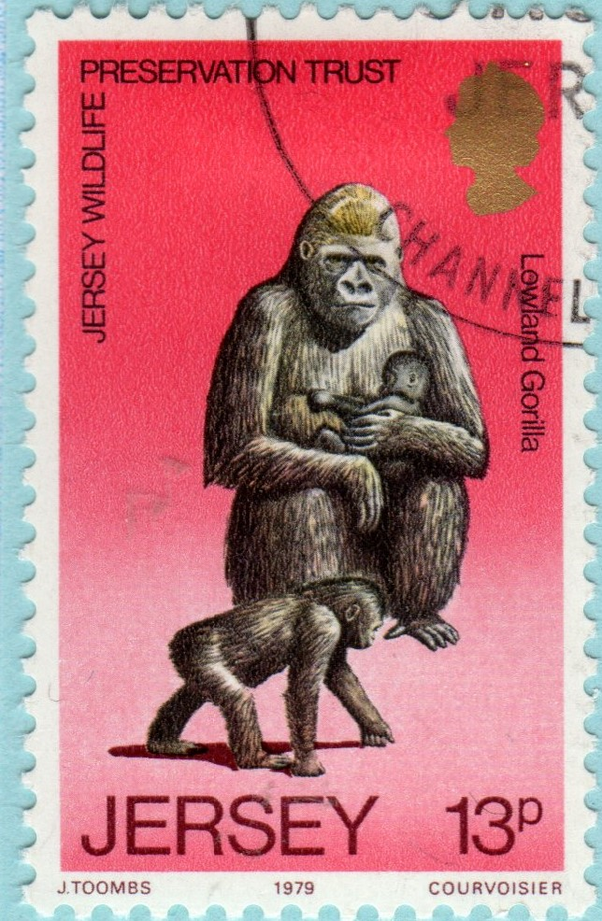
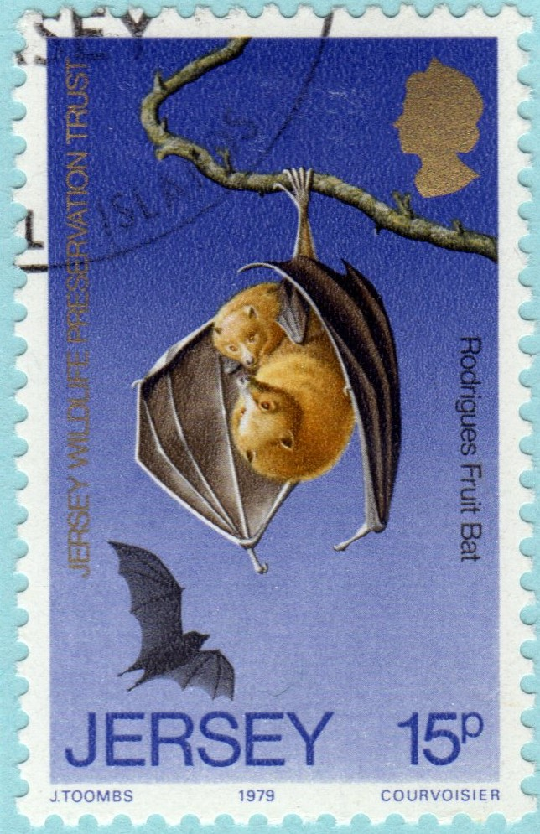
Cont.
WILL THE ONLY SECURE FUTURE FOR WILDLIFE BY IN A ZOO?

Slide 7
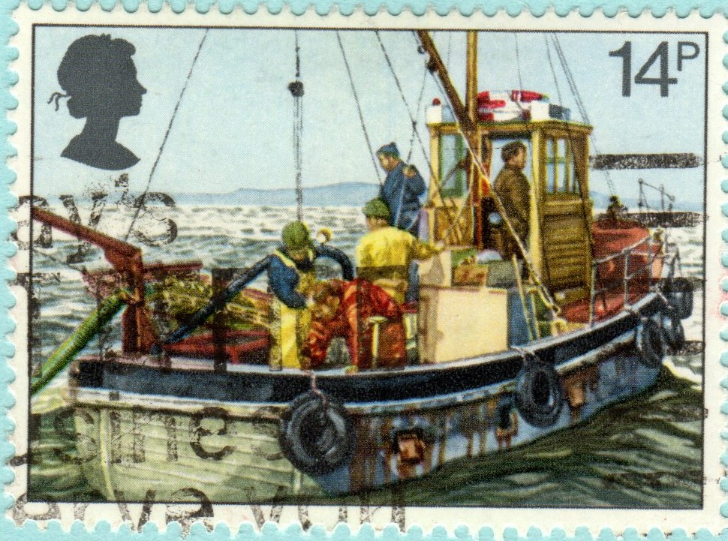
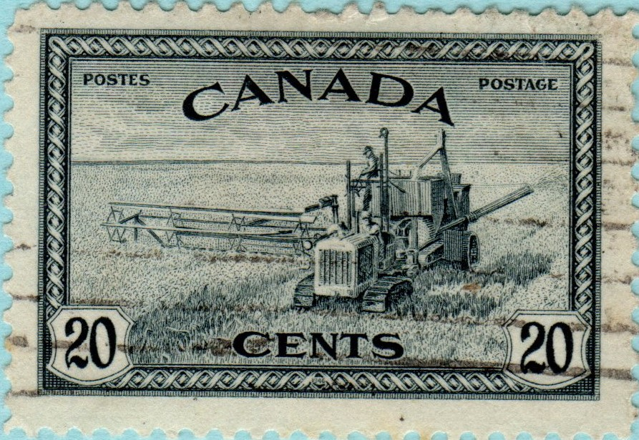
POLLUTION OF THE FOOD CHAIN
Herbicides and Pesticides are sprayed on most crops. These leach into water courses and into the Sea affecting Fish stocks.
“Will that nice Rosy Apple imported through Dover really keep the Doctor away”?

Slide 8
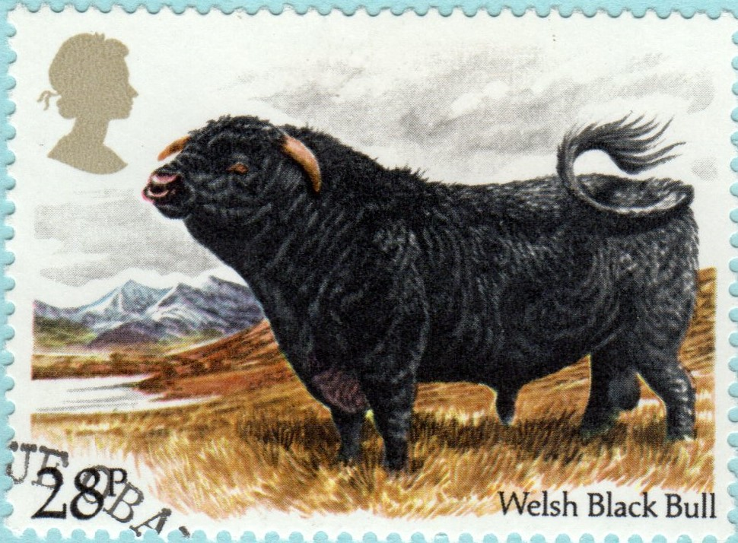
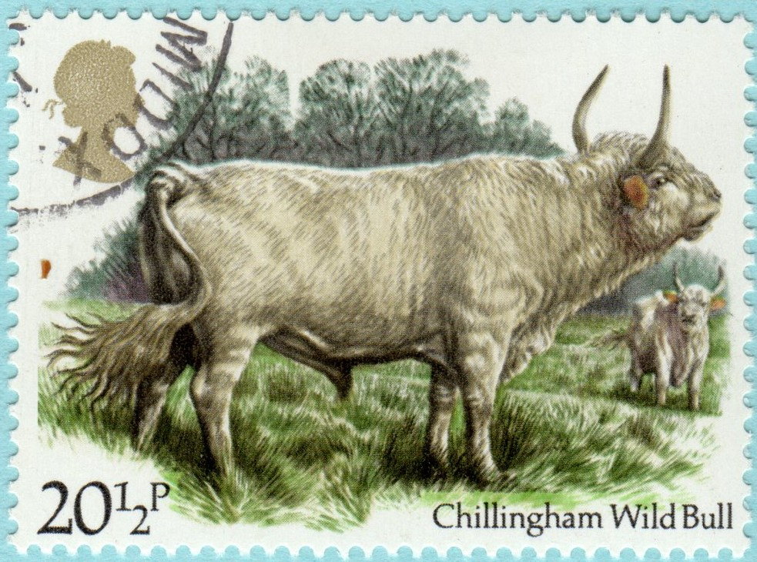
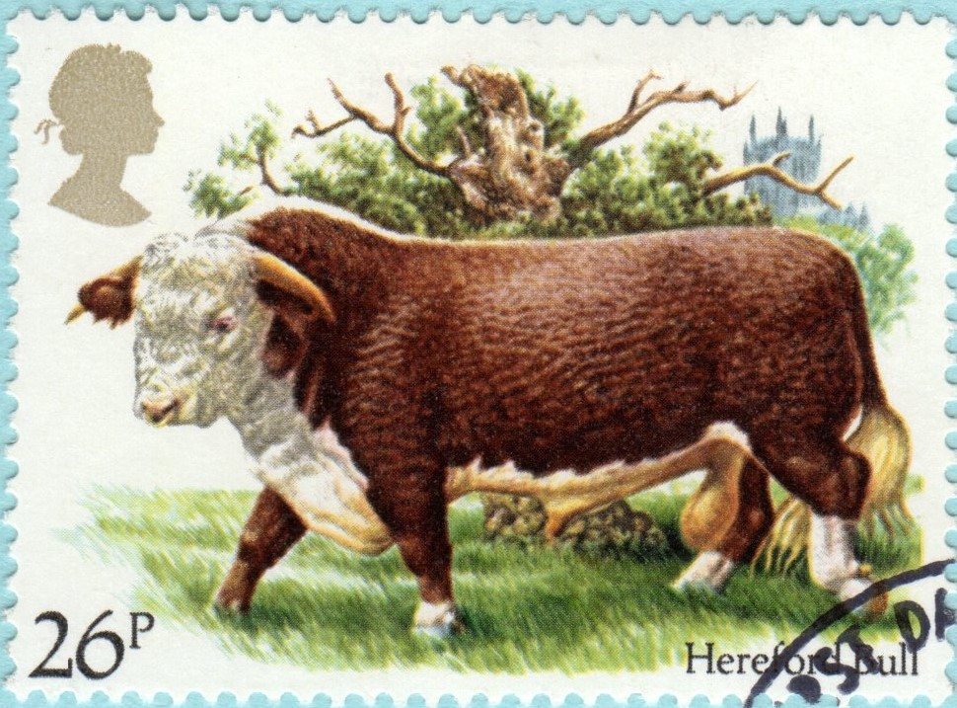
Cont.
Perhaps the major catastrophe to the Human Race in the 20th Century, brought about by mans greed for greater and greater profits, regardless of consequence, has been the contamination of Cattle Feed, by the use of Sheep Offal, leading to BSE and the Human Variant CJD.

Slide 9
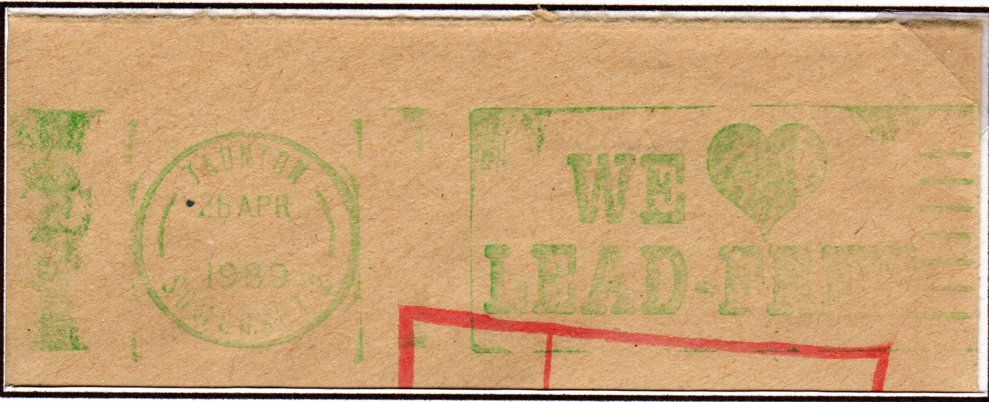
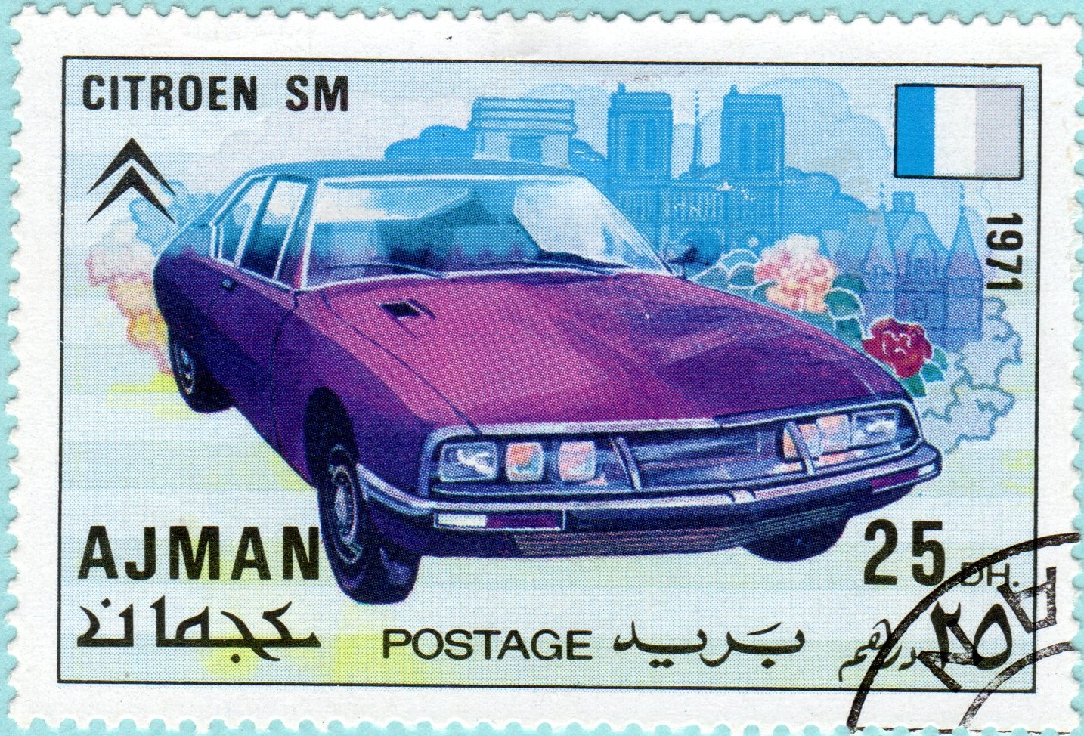
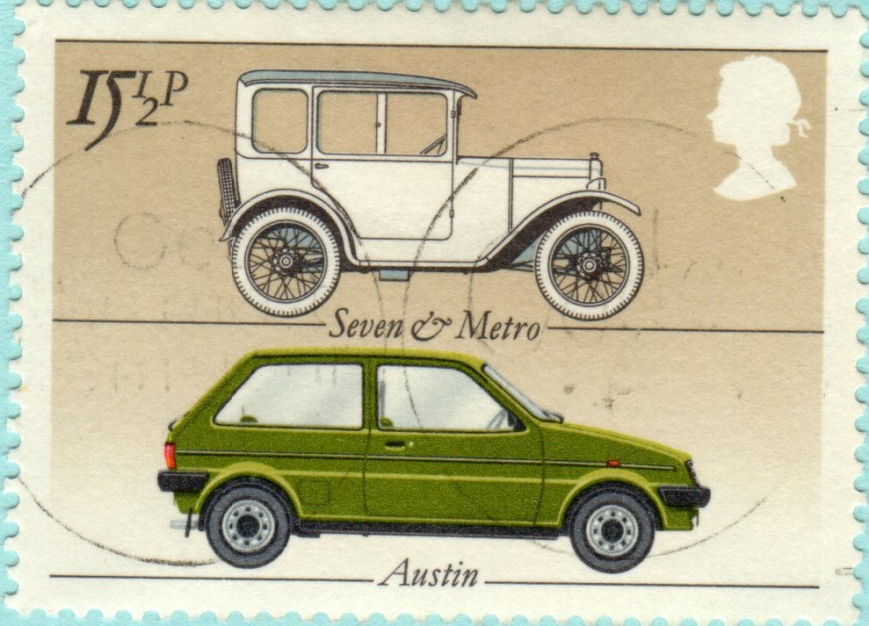
POLLUTION OF THE AIR
Mans long term love affair with Motorised Vehicles is on of the major sources of air pollution in the world today. The reductions in lead solves one problem, but does little to solve overall air pollution

Slide 10
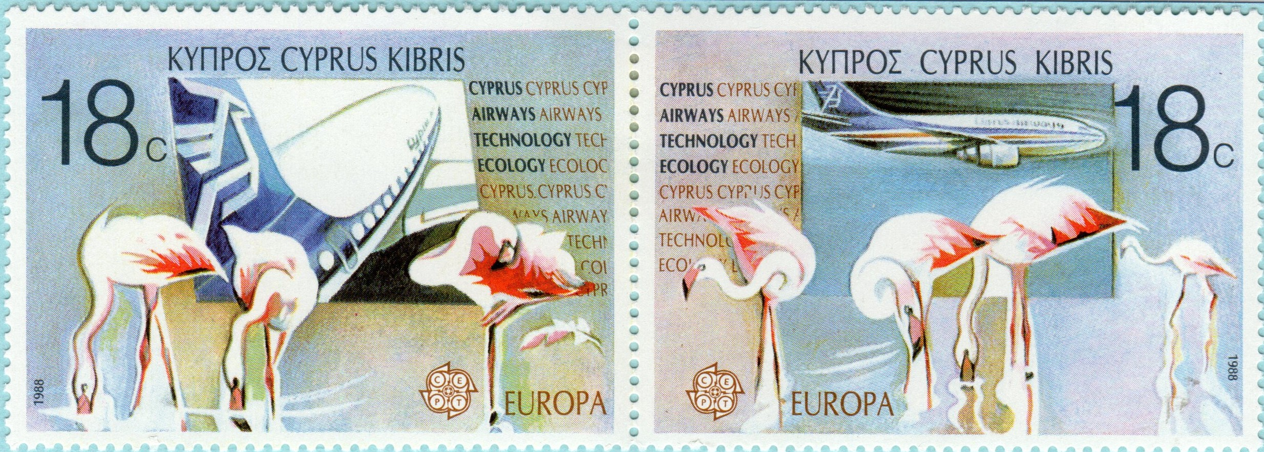
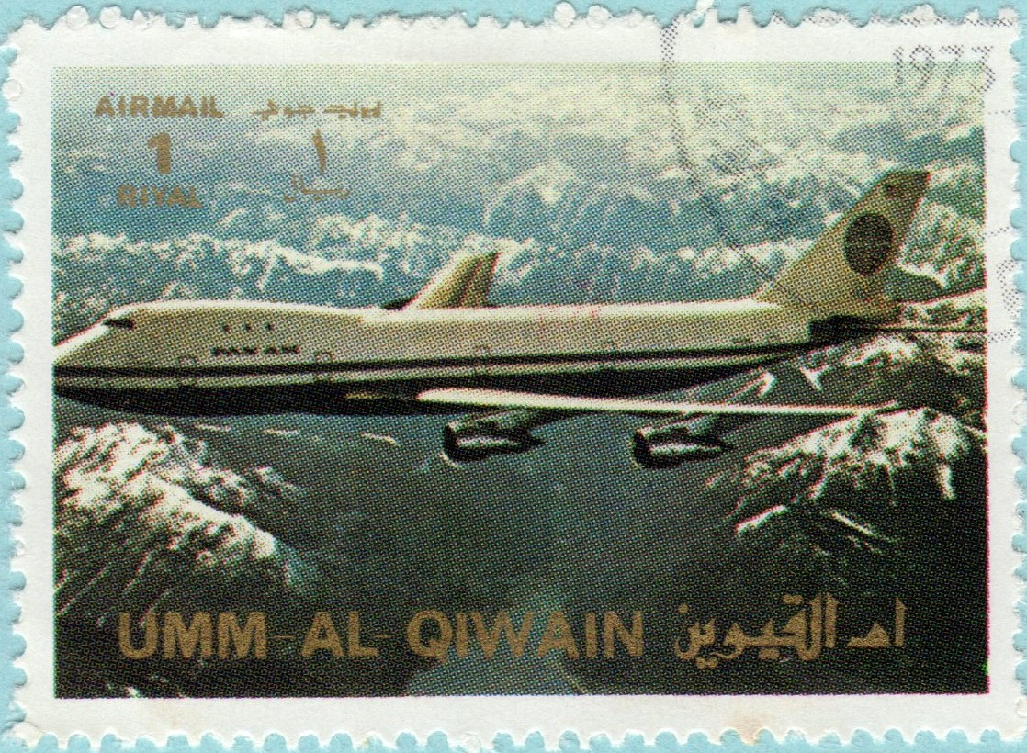
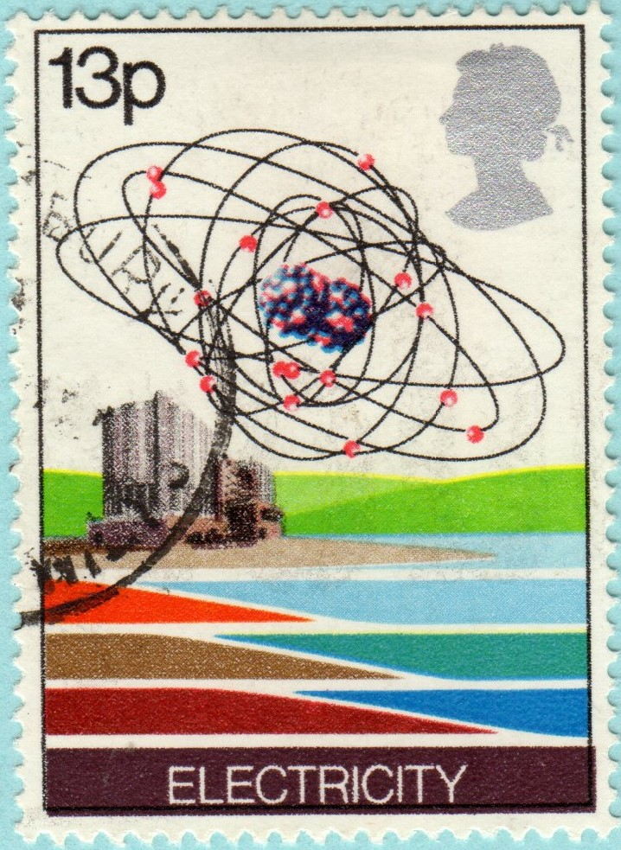
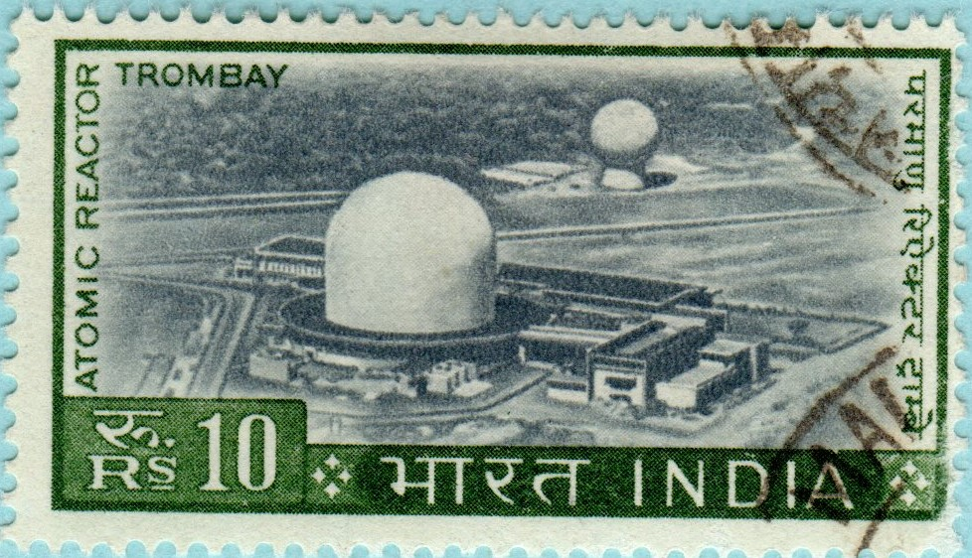
Cont.
A more recent contributor to Air Pollution comes from the mass of Aircraft now in our Skies.
The Nuclear Industry around the World has also added to pollution by releasing contaminants into both the air, ground and sea.

Slide 11
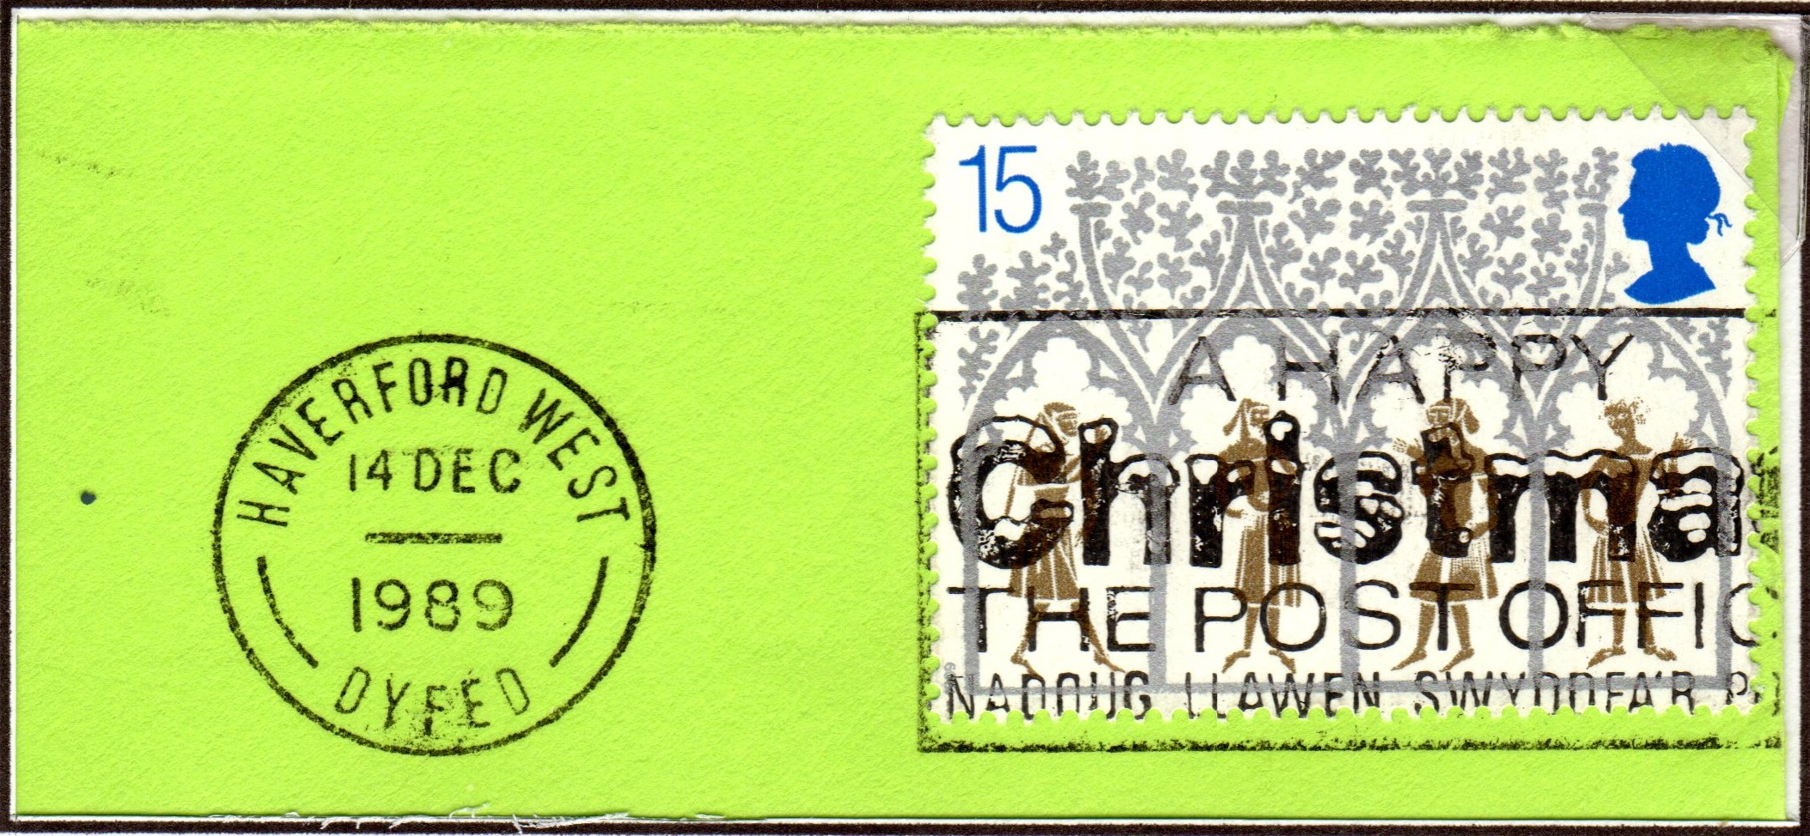
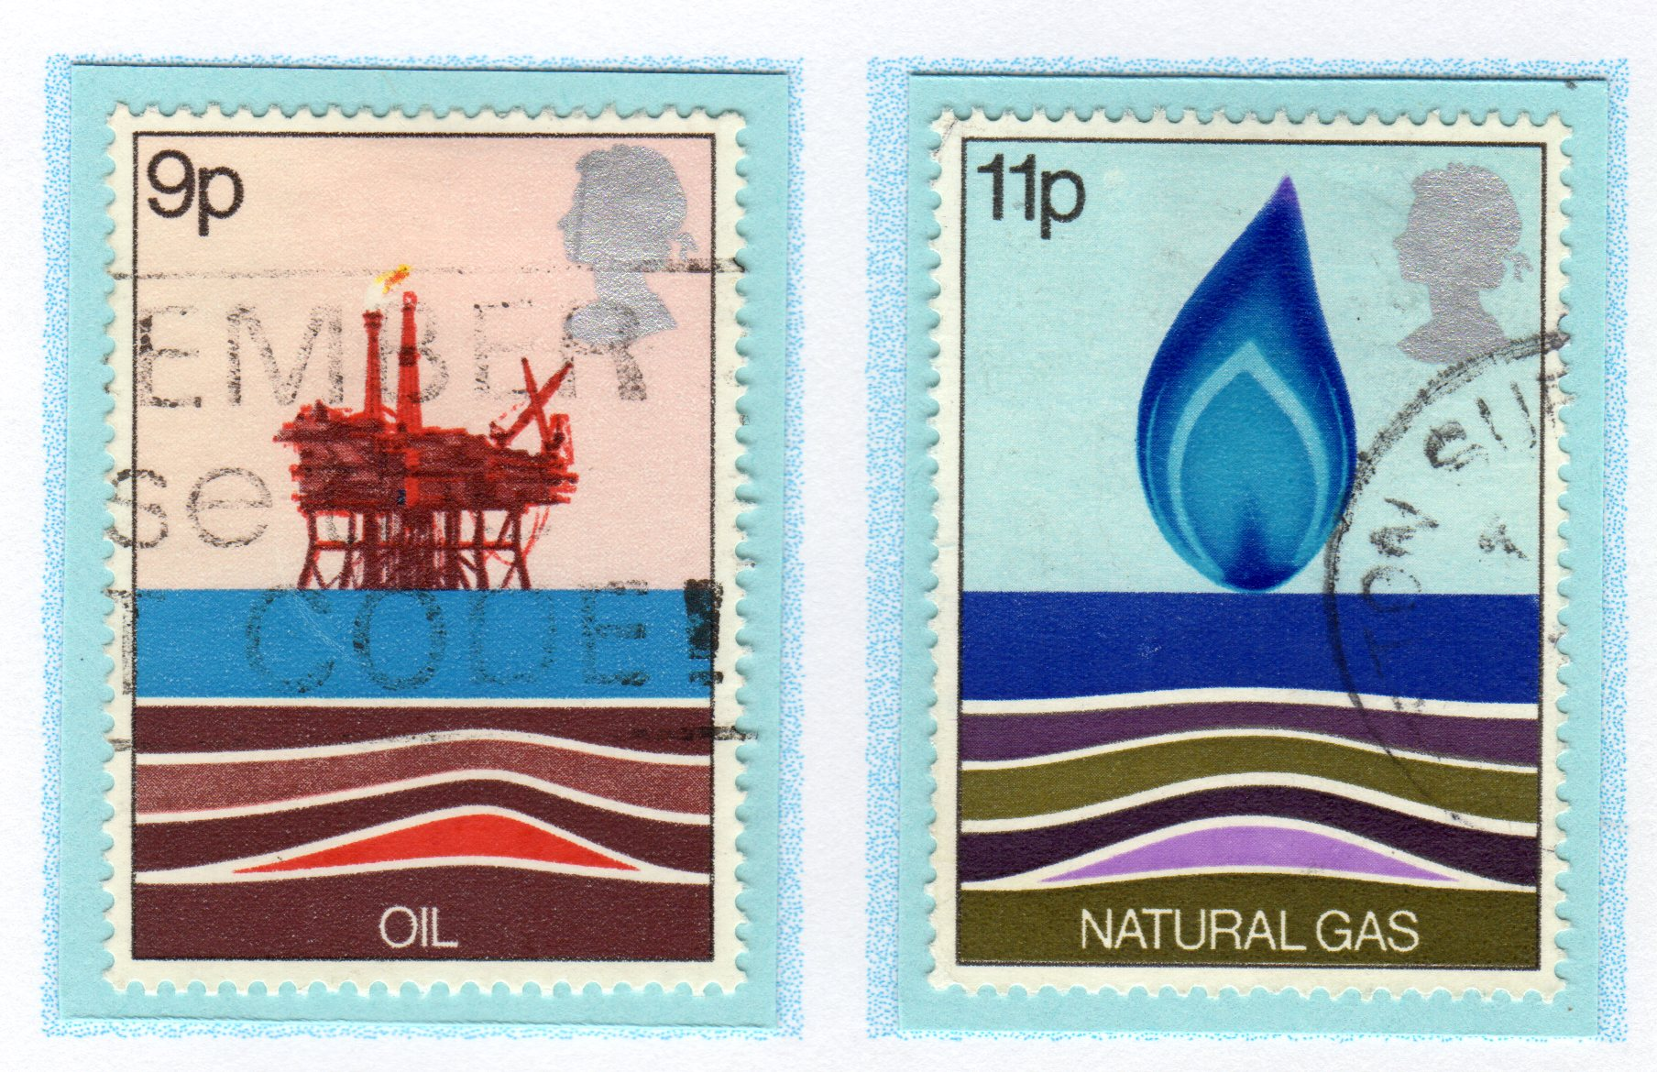
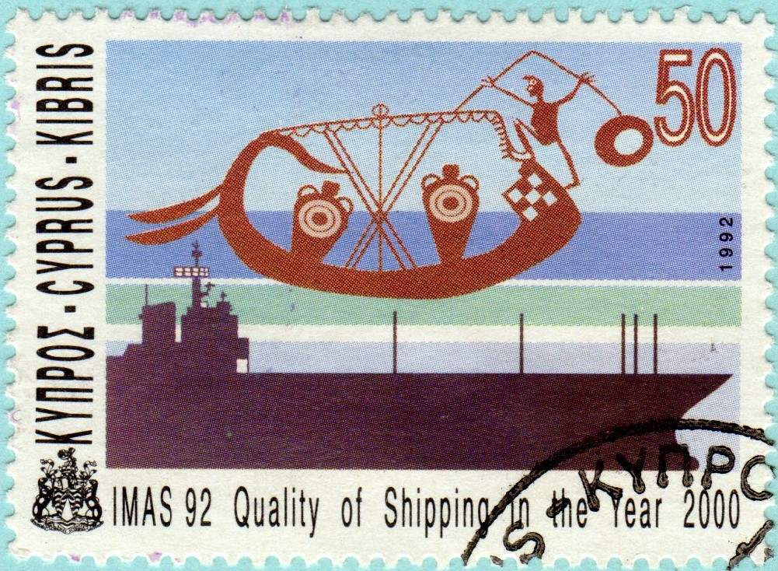
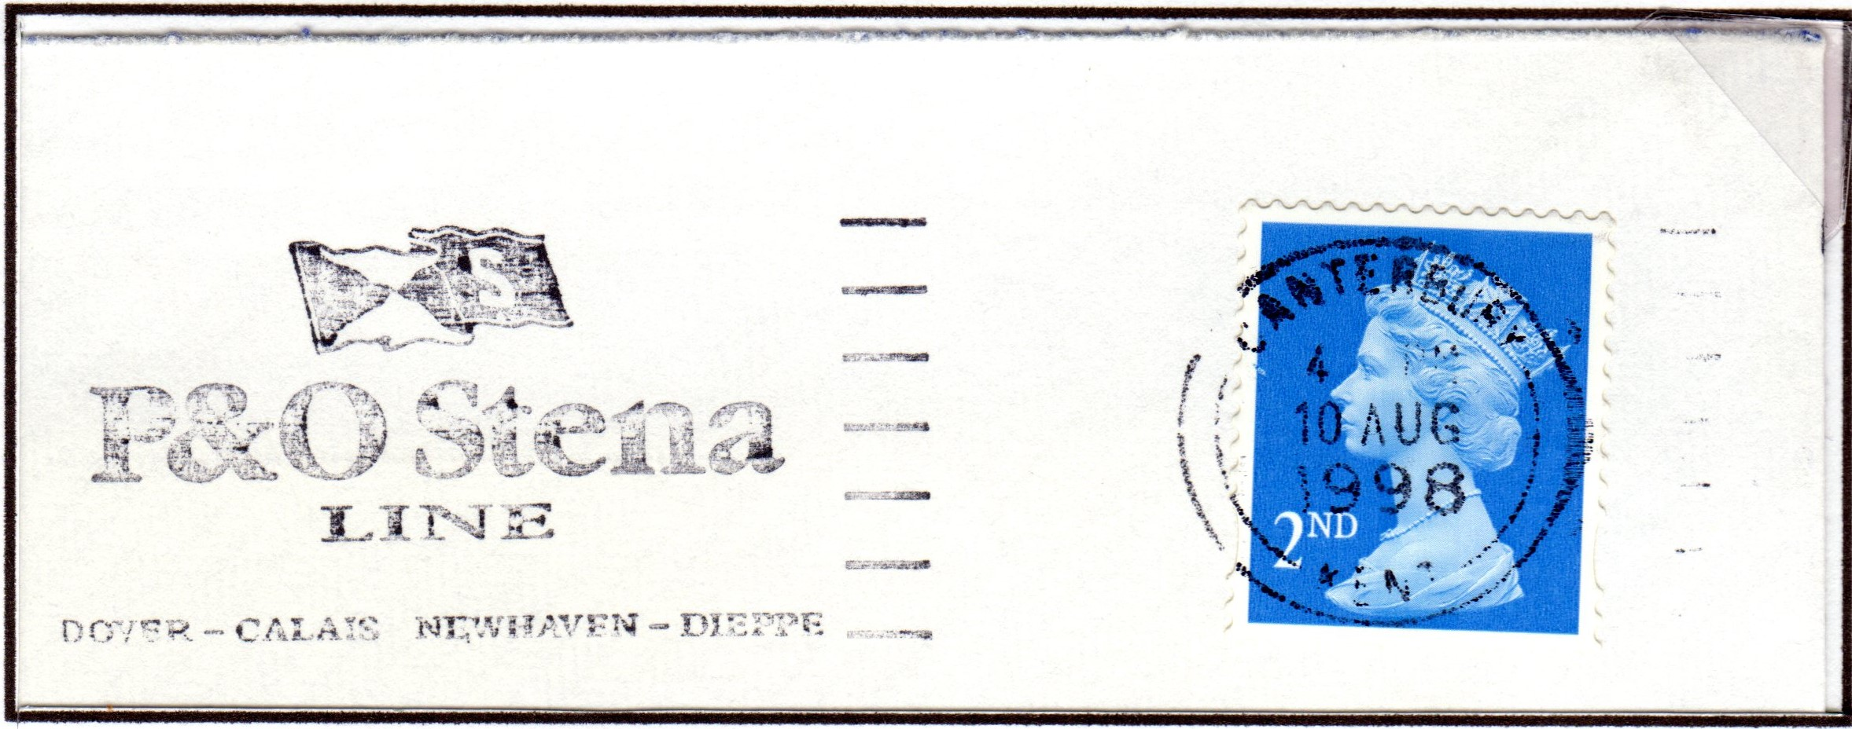
POLLUTION OF BOTH RIVERS & SEA
We may receive green covers from Haverford West but their nearby Oil Terminal along with the Offshore Oil and Gas Industry are major polluters of the Sea.
Oil Tanker Accidents and deliberate fouling of the Sea by Shipping all plays a part in the pollution of both Sea and Tidal Rivers

Slide 12
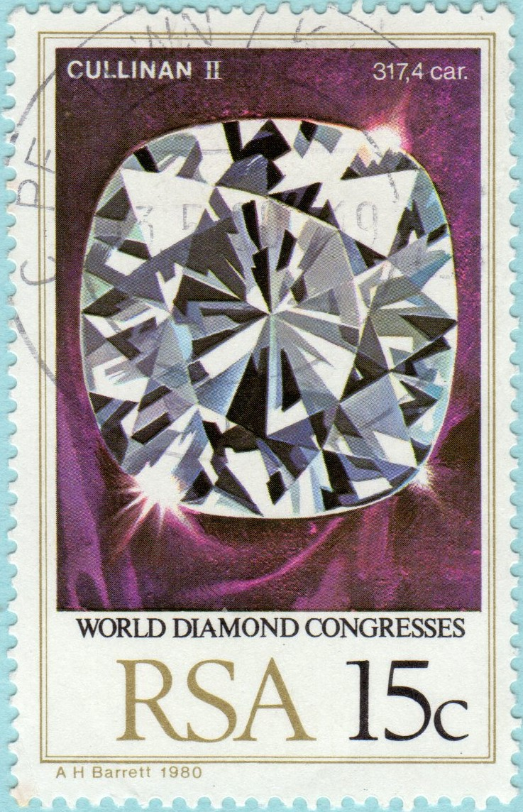
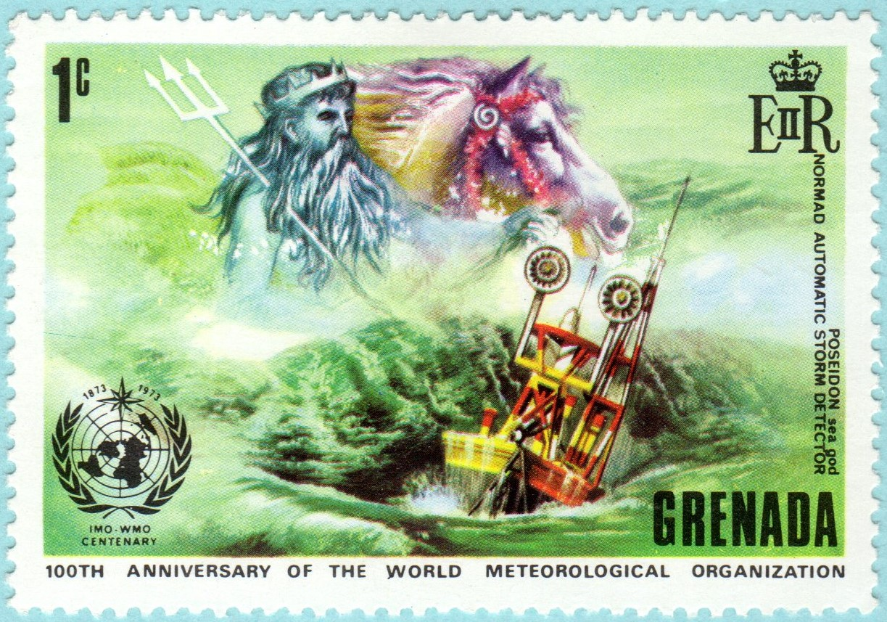
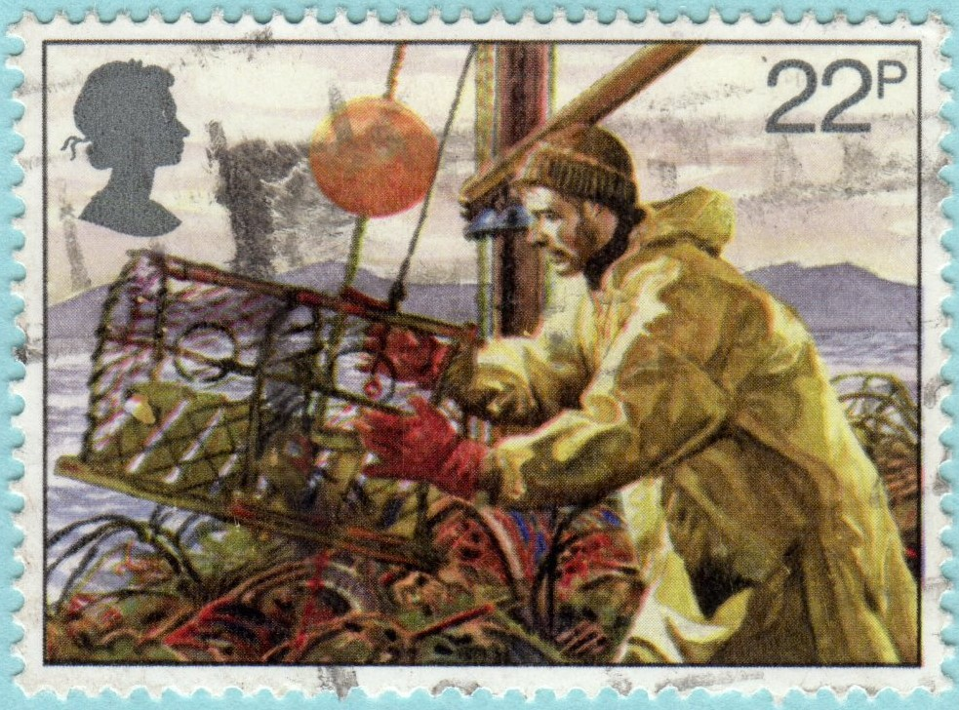
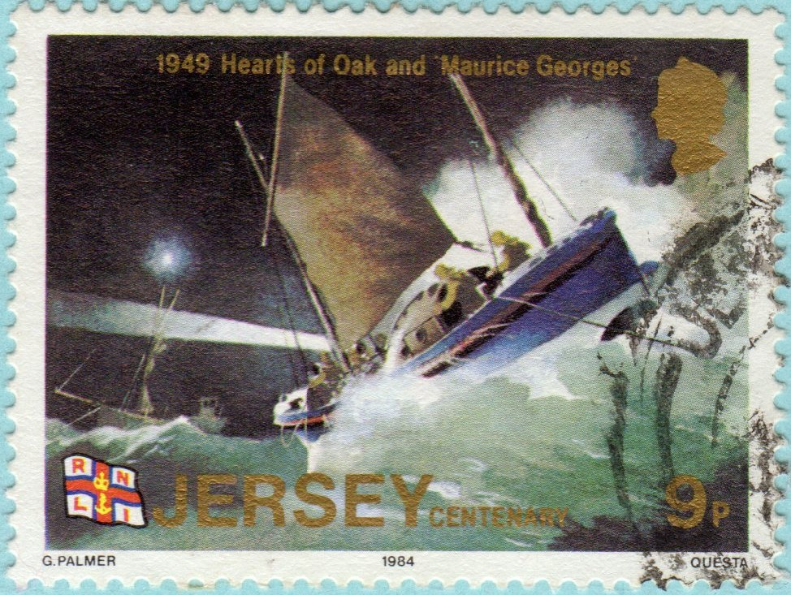
Cont.
Mining for Minerals and Precious Stones causes the pollution of Rivers and kills off Fish Stocks
These changes being made to the Rivers and the Sea are causing climatic changes to our weather patterns.

Slide 13
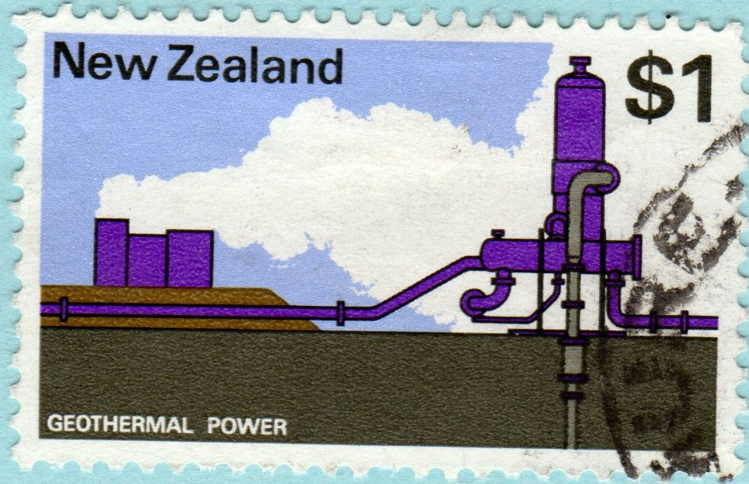
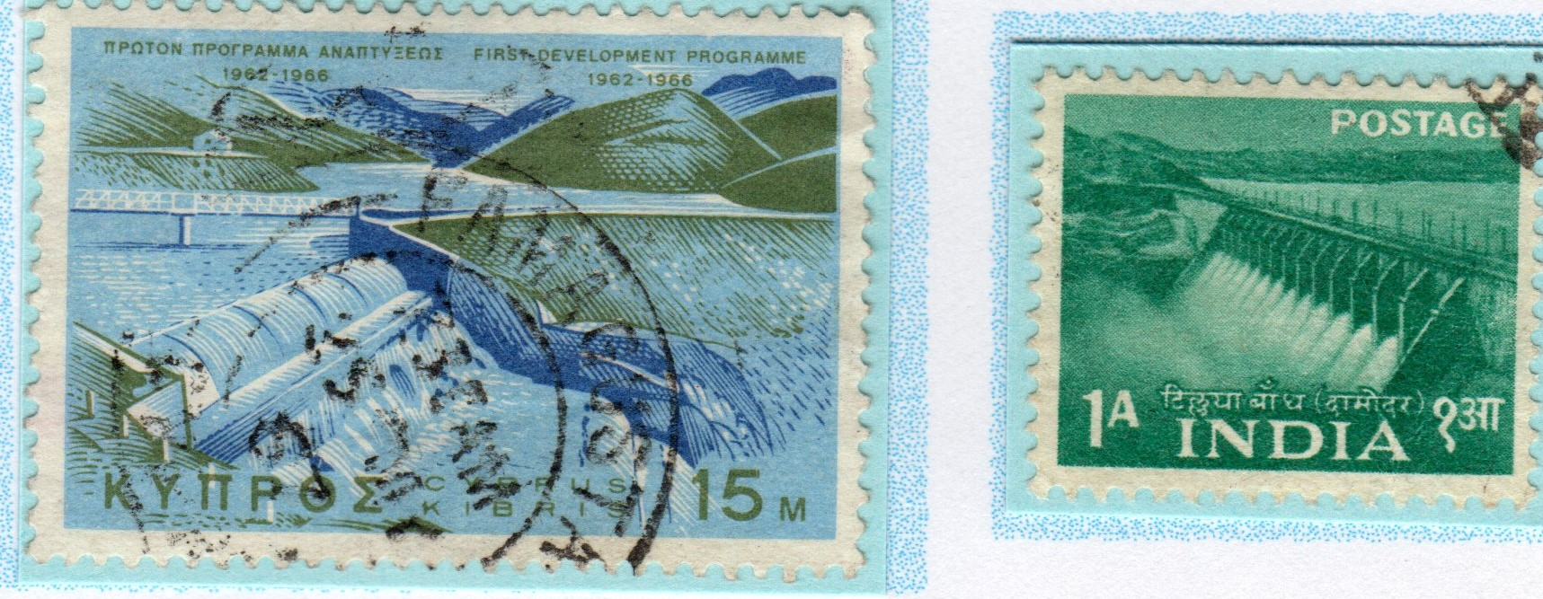
INABILITY OR UNWILLINGNESS OF GOVERNMENTS TO STOP DESTRUCTION
The Worlds Governments talk about the use of renewable forms of energy, such as Hydroelectric, Geothermal and Wind, however THEY DO NOT AGREE AND ACT
Government Social Reform does little to make real improvement in peoples lives and does not tackle issues such as reducing use of energy and some of the causes of that use

Slide 14
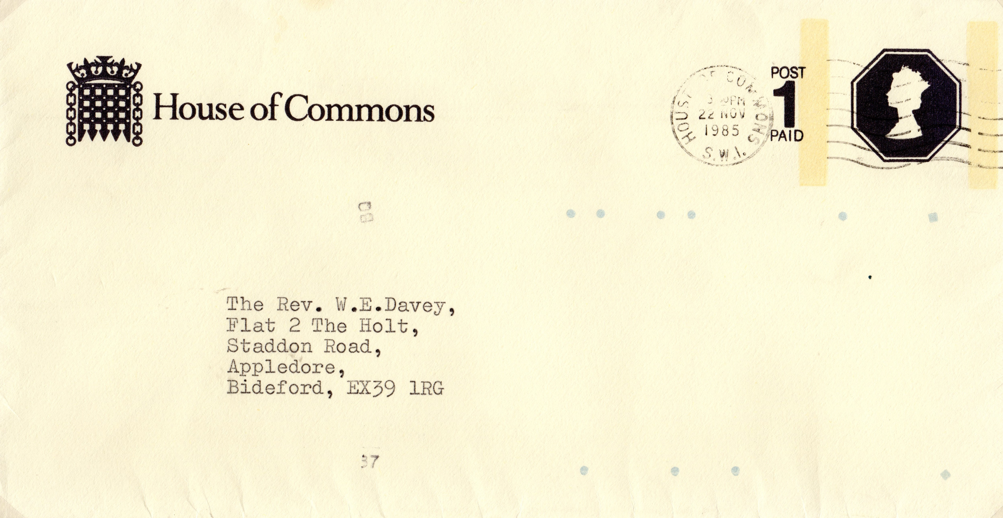
Cont.
Government are only interested in results obtainable during their term of office, so we are unlikely to receive letters from our MPs containing anything other than EXCUSES AS TO WHY THEY ARE NOT ACTING TO REDUCE THE DESTRUCTION OF OUR PLANET.
IS MAN PREPARED FOR NATURES REVENGE
End of Group

